Slide 1

Bivariate Data Analysis
Chapter 7-10
AP Statistics
Mrs. Watkins

Slide 2


Two Questions of Bivariate
Data Analysis
What is the degree of linearity?
is there a line?
What is the degree of association?
how strong is the line?

Slide 3



Explanatory Variable
Independent Variable
What is the “x”?
Usually what the researcher is trying to manipulate

Slide 4



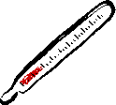
Response Variable
Dependent Variable
What is the “y”?
What the researcher is trying to see an effect on

Slide 5
If we want to predict y, what could x be?
Predict weight of human males
Predict Math SAT score
Predict college freshman GPA
Predict amount of growth of a shrub
Predict blood alcohol content of driver
Predict cost of building a house

Slide 6
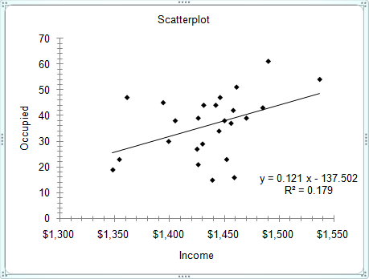
Scatterplot
Definition: graph of two variables
with dot to represent each observation

Slide 7
“Comment on the Scatterplot”
Shape: Does relationship look linear?
Outliers: Are there any unusual points?
Direction: Is linear relationship positive
  or negative?
  Strength: Is the line strong?

Slide 8
Correlation
Definition: Measures the strength of the
linear relationship between variables
r is the symbol for correlation
r takes on values between -1 and 1
0 means no linear relationship
-1 and 1 mean perfect linear relationship

Slide 9
Correlation ≠ Causation
Just because you have a high r value does not mean that x causes y…be careful!!
There could be a “lurking variable” that actually is the cause.

Slide 10
Minutes Late to Work
Direct Causation: late to work and rain
Reverse Cause and Effect: late to work
and poor relationship with boss
3rd variable: late to work and rain and # of children at home
Coincidence: late to work and height

Slide 11
Regression Line
Linear model created by bivariate data set
This equation represents “line of best fit”
Serves as the “prediction line”

Slide 12
Regression Line formula
Recall equations of line
Algebra Line: y = mx + b
Statistics Line: y = a + bx
a = y intercept
b = slope

Slide 13
a = y intercept
The value of y if x = 0
**often has no real meaning in context
of the data

Slide 14
b = slope
On average, for every increase of one unit in x (explanatory variable, y (response variable) increases or decreases by this amount.”
recall slope = Δ y
Δ x

Slide 15
Interpret slopes of Regression Lines
Length = 90 – 3.2 (temp in F)
Income = 22.3 + 0.65(years of service)
Score = 40 +3.24 (attempts)

Slide 16
Goal of Regression
To be able to predict a response based on a value of an explanatory variable
Example: Predict a student’s college GPA based on SAT score
Example: Predict how much a baby’s temperature will go down with x amount of Tylenol

Slide 17
Residual
Residual: the amount in the y direction
that a point is from the regression
line
Residual = actual value – predicted value
Positive residual—point above the line
Negative residual—point below the line

Slide 18
Line of Least Squares
The regression line is sometimes called the line of least squares.
The “best fit” minimizes the squares of the residuals of each point from the
regression line

Slide 19
Example: Age and BP
AGE:
43 48 56 61 67 70
Blood Pressure
128 140 135 143 138 152

Slide 20
r
r is the correlation coefficient
*Measures strength of linear relationship
*Can be positive or negative
*Is always a number between -1 and 1

Slide 21
r²
r² is the coefficient of determination
*Measures what % of the variation in y
is explained by (or determined by)
the variation in x
*Will be given as a %

Slide 22
1-r²
1 – r² is the coefficient of non-determination
*Measures what % of the variation in y
which is explained by chance and other
factors
*% of variation in y NOT explained by
variation in x

Slide 23
Is Linear Model Appropriate?
How do we answer this question?
Check SCATTERPLOT and r value for
strong linearity
Look at RESIDUAL PLOT—it should
be random

Slide 24
RESIDUAL PLOT
A graph of the residual values compared to the x values.
We do not want to see a pattern of residuals increasing or decreasing or fitting any noticeable curve.

Slide 25
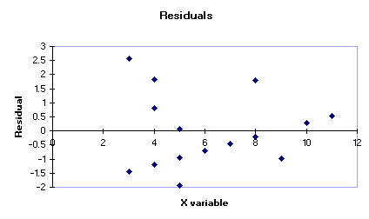
Good Residual = Random

Slide 26
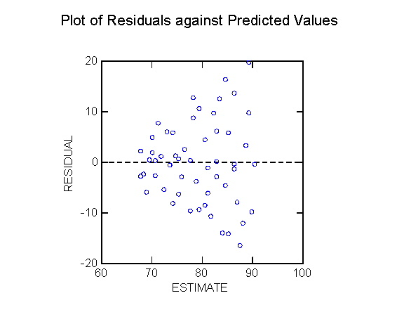
Bad Residual = Pattern

Slide 27
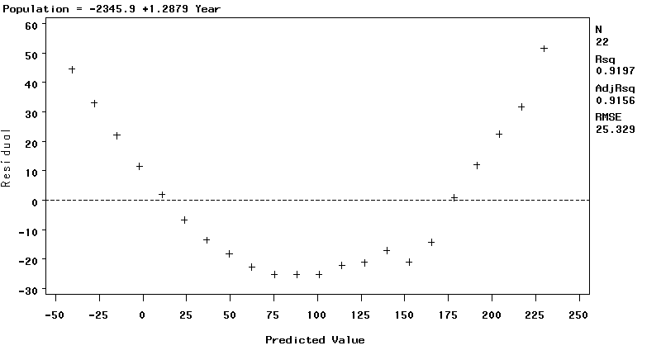
Bad Residual = Pattern

Slide 28
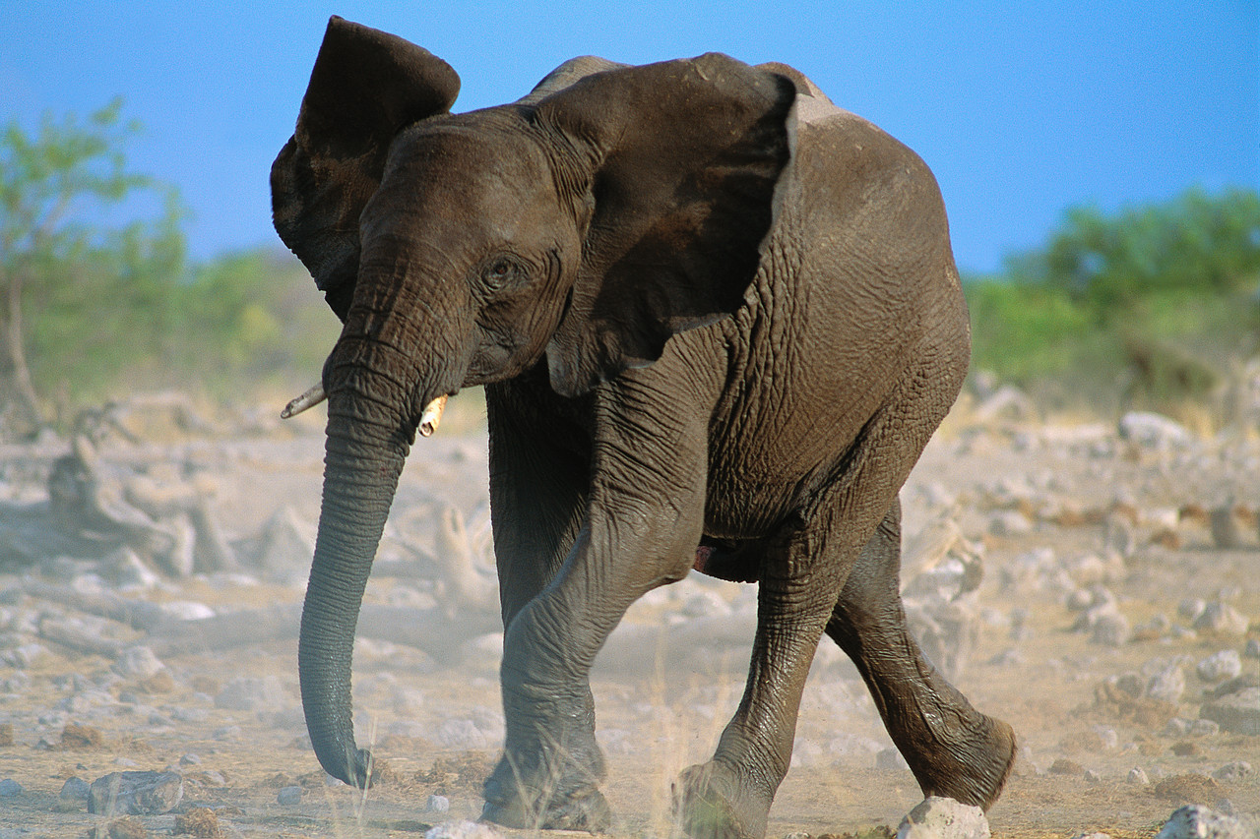
Unusual Points?

Slide 29
Influential Point
A point that strongly affects the regression line. (Usually an outlier, but not always.)
How to check? Remove it from the data and
recompute regression line to see if line
changes dramatically. Usually have to plug in a point to each regression equation to see if it matters.

Slide 30
Outlier
A point in regression analysis can be an outlier in x, an outlier in y or an outlier in both x and y.
How to check? Examine graph to see if one point seems far away from the rest in x or y direction and do outlier test on that variable.

Slide 31
Extrapolation
The goal of regression is to create a model to predict, but you must be careful how far beyond the range of the original data you
predict for.
Predicting y for an x far beyond the range is called extrapolation.

Slide 32
Good Model = Causation??
If a linear regression model is good (strong r, linear scatterplot, random residuals), that DOES NOT mean that x causes y.
For a researcher to assert that x causes y, the data must have come from a PLANNED, CONTROLLED EXPERIMENT.

Slide 33
r = -.62
What can we say about the level of association between x and y??
*moderate negative linear association
*Only 38% of the variation in y is
explained by the variation in x.

Slide 34
Re-expressing data=transformation
We transform data if a linear model is not appropriate.
Transforming data means re-expressing the numbers using algebraic operations that take the “curve” out of the original data.
Examples: take square root, take log or ln,
use reciprocals

